Slide 1
Chatbot Development for Regional Languages
Members:-
1)Ketan Makwana
2)Ganesh Kamath
3)Gaurav Hulmukh

Slide 2
Introduction
A chatbot system is a software program that interacts with their own language known as Natural Language.
The purpose of the system is to simulate a conversation with human in such a way that it becomes difficult for the human to believe that he is talking to a machine.
The chatbot architecture includes a language model and pattern matching algorithms to emulate informal conversation between a human and a system using Natural Language Processing.

Slide 3
Abstract
Chatbot can be described as software that can chat with people using artificial intelligence.
This software are used to perform operations such as quickly responding to users,informing them,helping to purchase products and providing better service to customer
This chatbot has special feature of supporting many regional languages.

Slide 4
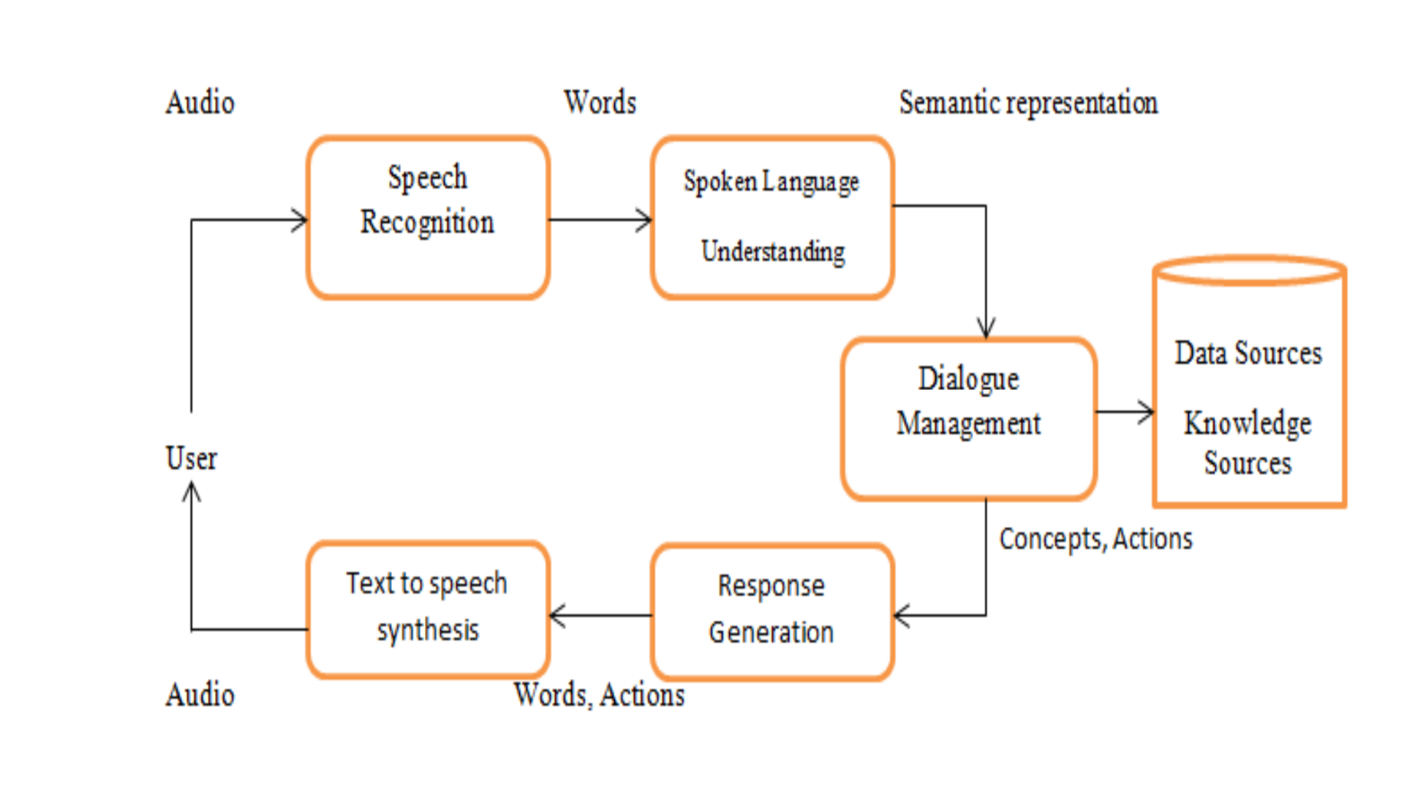
Proposed System
This chatbot is built with artificial algorithm that analyzes users queries and understand users message through speech recognition using Natural Language Processing.

Slide 5
Technology Stack
Python: Chatbot will be developed by using Python Programming Language as it is OOPs based, high level, interpreted programming language. It is a robust highly useful language focused on rapid application development.Natural Language Processing(NLP) will be used.
Android Studio: For Application Development i.e for front-end interaction with human
JSON(JavaScript Object Notation): for maintaining the database

Slide 6
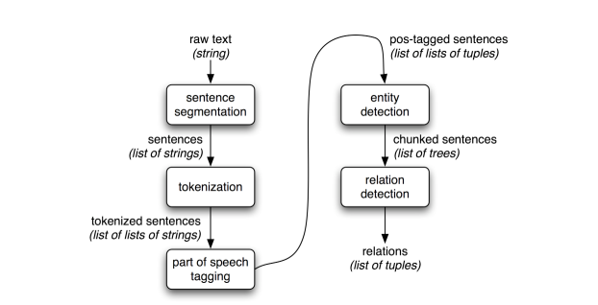
Libraries
The Natural Language Toolkit (NLTK) is a platform used for building Python programs that work with human language data for applying in statistical natural language processing (NLP). It contains text processing libraries for tokenisation, parsing, classification, stemming, tagging and semantic reasoning. As our project chatbot is highly concerned with working with human language and speech recognition,we will be using NLTK.

Slide 7
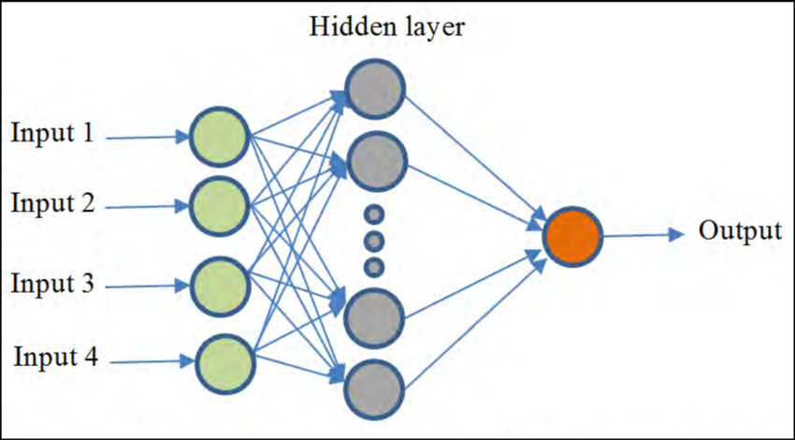
ANN

Slide 8
Dependencies
Packages for speech recognition:-
Google-cloud-speech:- enables developers to convert audio to text by applying powerful neural network models in an easy-to-use API. The API recognizes 120 languages and variants to support your global user base.
Pocketsphinx:- is an Open Source Toolkit For Speech Recognition.
Wit:-

Slide 9
Thank you

